Slide 2
Overview
Booth vs Nünning
Olson’s Three Unreliable narrators
Our hypothesis on narrator influence
Research Questions
The test game
Test question strategy
Conclusions

Slide 3
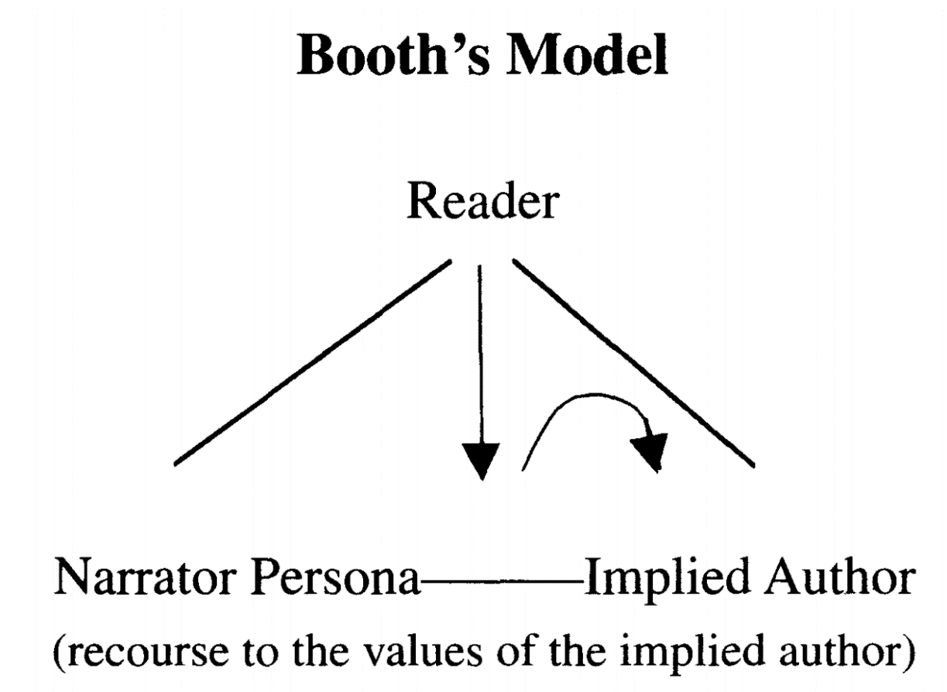
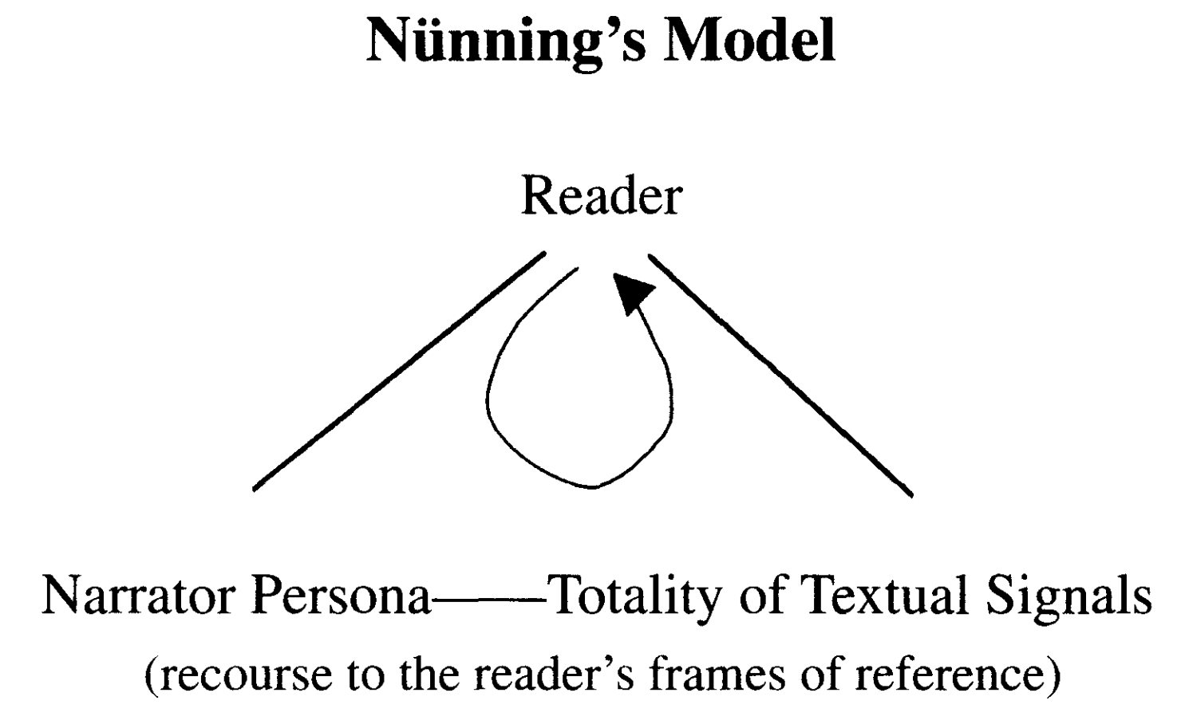
Booth vs Nünning

Slide 4
Olson’s definition of unreliable narrators
Reliable narrators
Fallible Narrators
Untrustworthy narrators

Slide 5
Our hypothesis on narrator influence
Voice
Focalization
Distance

Slide 6
Research question 1
What influence does the narrator have on decision-making in games?

Slide 7
Research question 2
Does the player experience an untrustworthy as reliable
if almost no contradictions are given in the narrative?

Slide 8
The test game

Slide 9


Slide 10
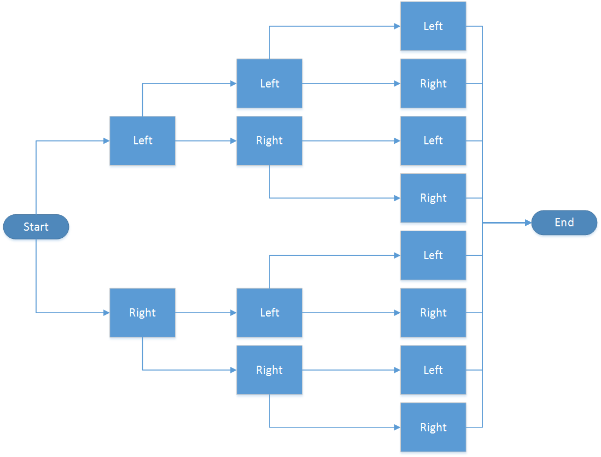

Slide 11
Test question strategy

Slide 12
Results

Slide 13
Conclusions

